Slide 1

Sentiment Analysis of Social Media Posts

Slide 2
Team member
Eslam mohamed
Mohamed adel

Slide 3
Roles
Eslam Mohamed
Data Collection and Exploration
Data Analysis and Visualization
Api
Presentation
Mohamed Adel
Sentiment Analysis Model Development
MLOps, Deployment
GIT & GITHUB
Presentation

Slide 4
TABLE OF CONTENTS
Project Overview
Data Sources
Methodology
MLflow Integration
api
Future Work

Slide 5
1-Project Overview
Objective: Sentiment Analysis of Social Media Posts
Techniques :Apply machine learning techniques for sentiment classification (positive, negative, neutral).
Goal: Improve prediction accuracy using machine learning

Slide 6

2- Data

Slide 7

3-METHODOLOGY
1-Data exploration:
deep into and explore the data
2-Data Preprocessing:
Cleaning, tokenization , Feature Engineering
3-Visualization:
Pie Chart,
Bar Plot(year, month, day, platform, country)
,Common Words(viz)
,Positive Common Words(viz)
,Neutral Common Words(viz)
Negative Common Words(viz)
4- Model Training:
Applying ML algorithms

Slide 8

3.1-Data Exploration

Slide 9

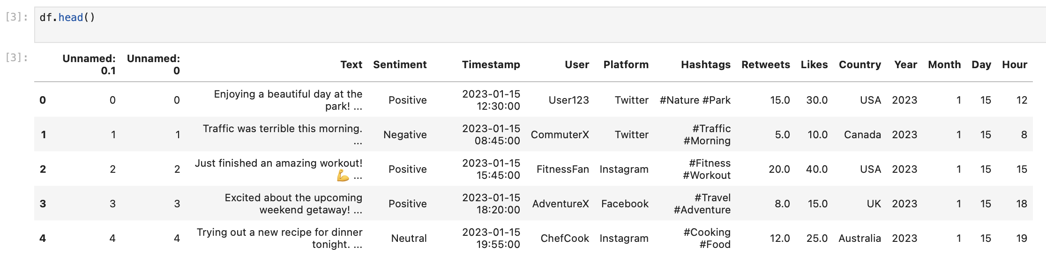
Let's start by taking a general look at the data.

Slide 10
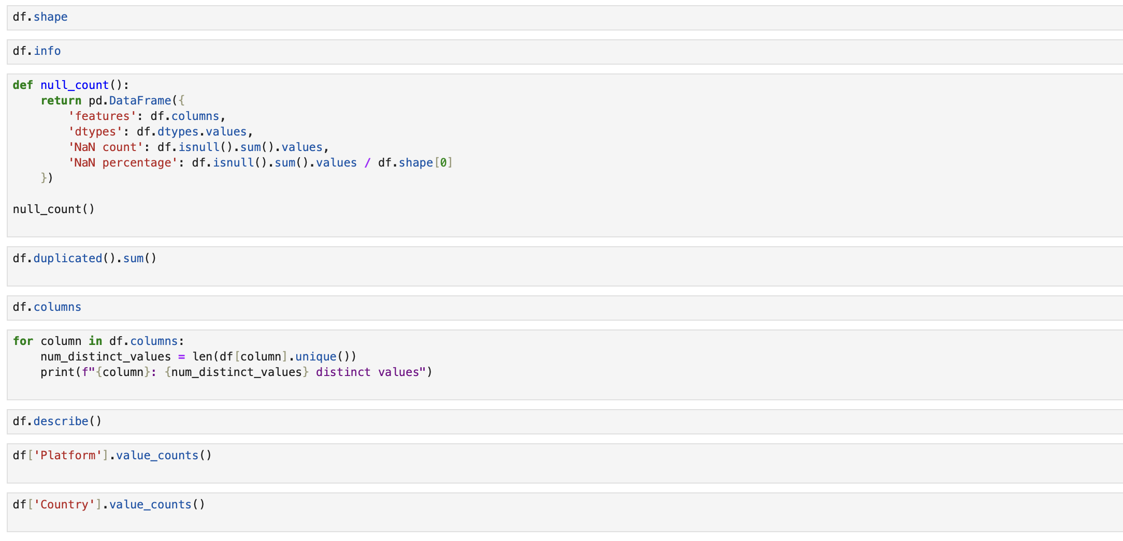
We try to delve deeper into the details of the data by calculating missing and duplicate values, taking a look at the number of columns and rows, and further describing the data.

Slide 11

3.2-Data Preprocessing

Slide 12
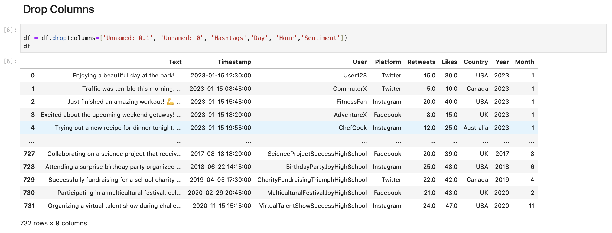
We deleted some columns
Not useful: Unnamed: 0.1, Unnamed: 0
Not necessary at this stage : Hashtags , Day , Hour , Sentiment

Slide 13
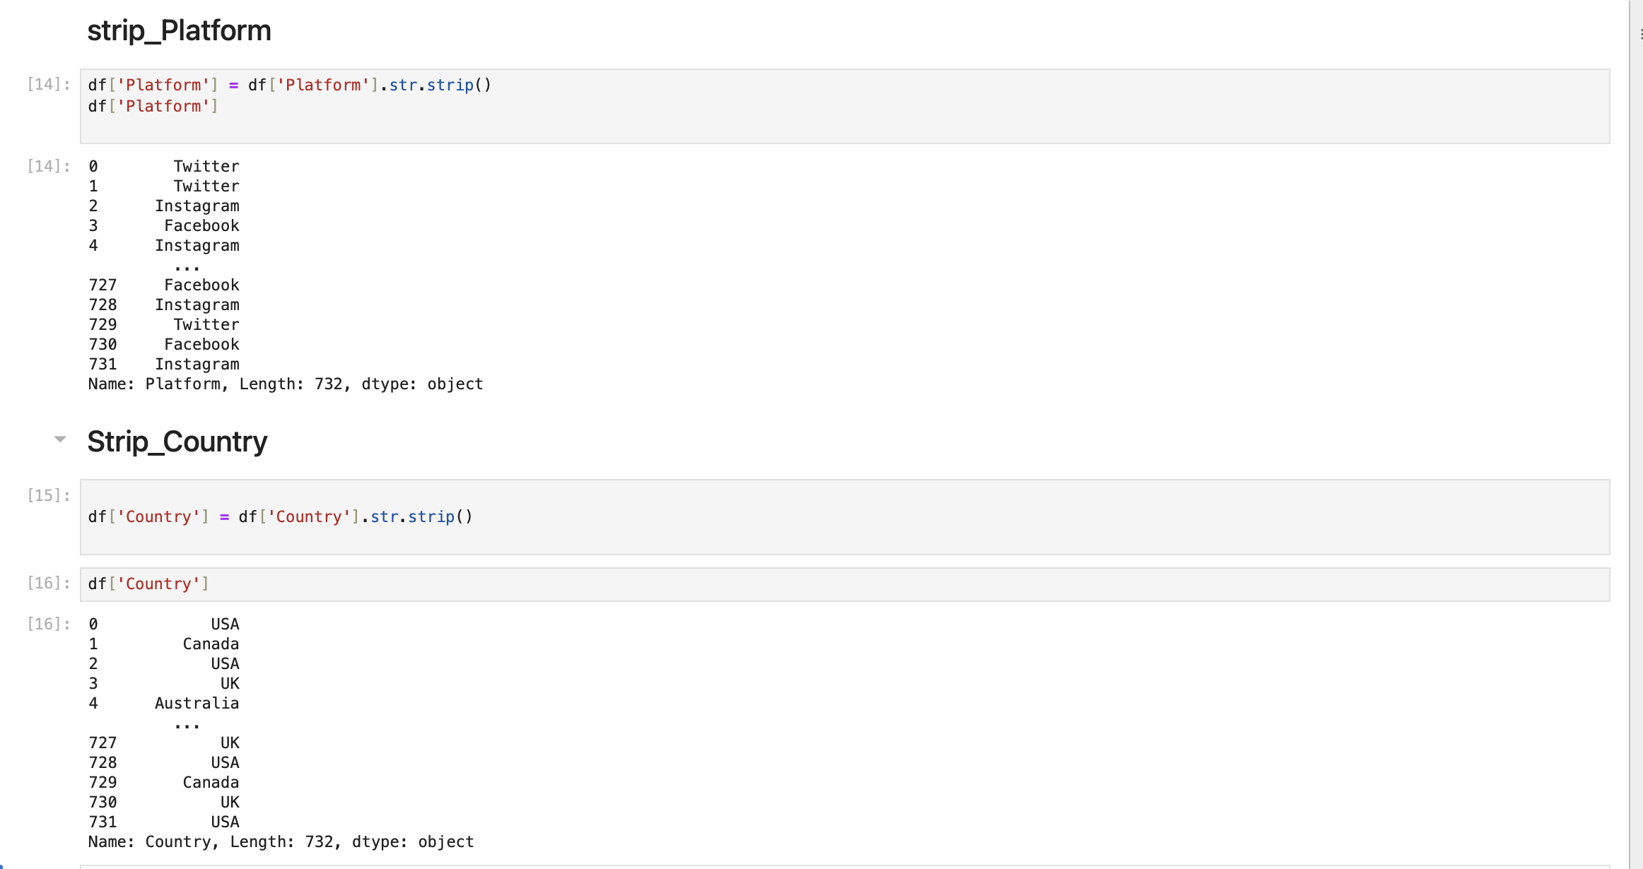
We removed extra spaces from some columns: because these spaces lead to problems in analysis, such as counting duplicate values ​​or aggregation, where the value that contains an extra space is considered different from the original value.

Slide 14
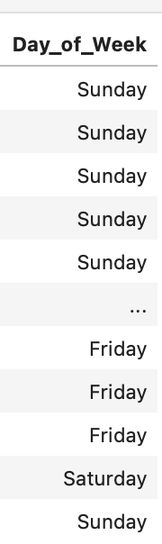
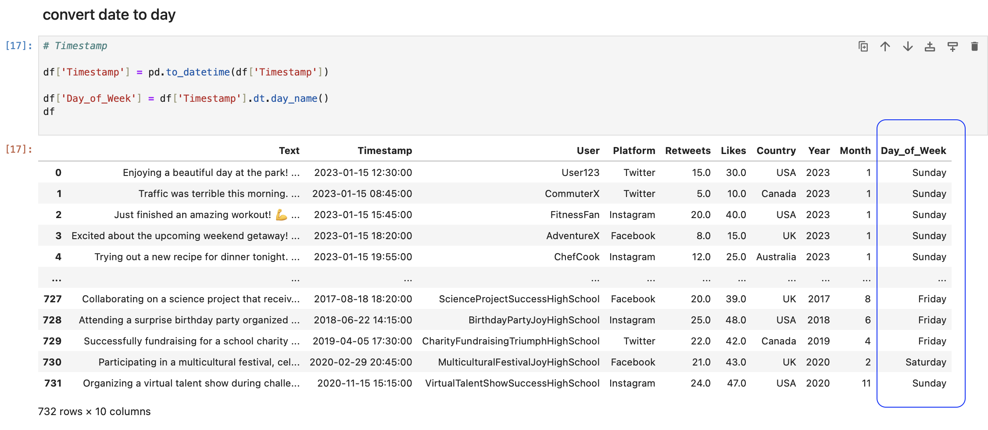
Feature Enginering

Slide 15
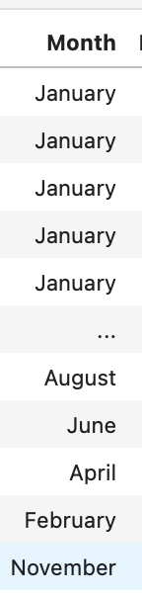
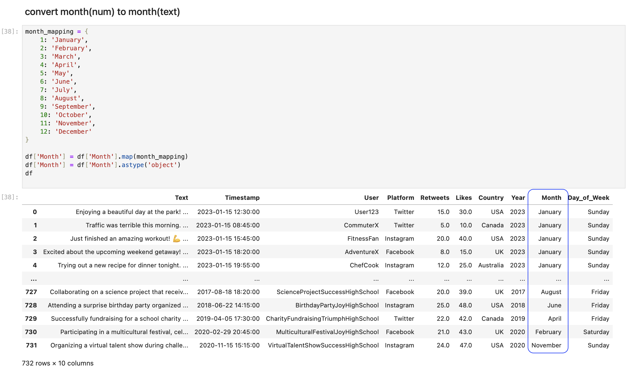
Feature Enginering

Slide 16
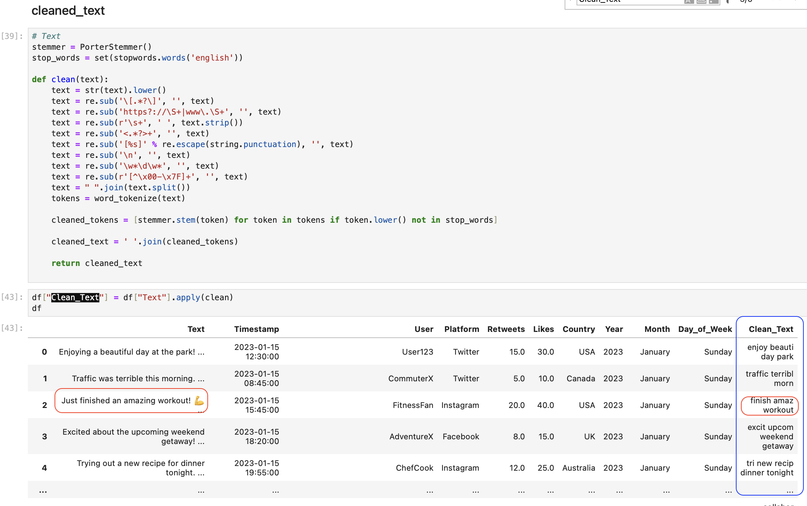
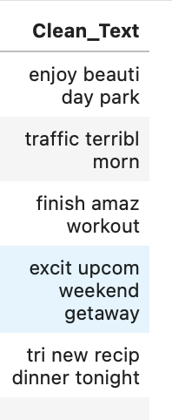
Feature Enginering

Slide 17

3.3 Visualization

Slide 18
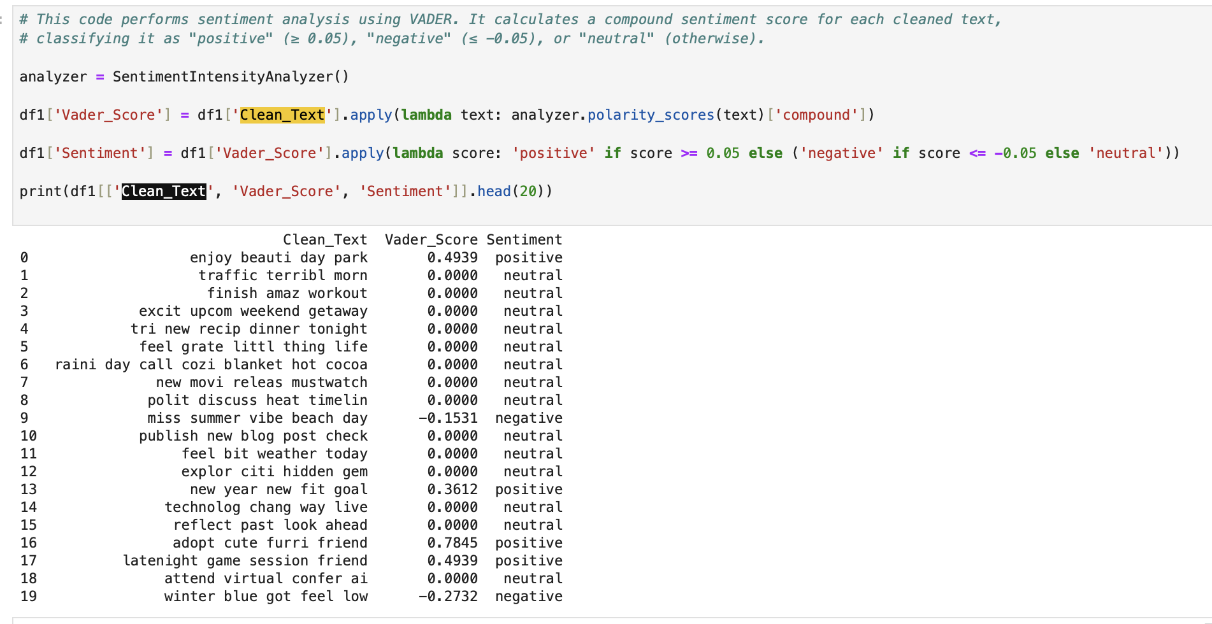
"The texts were analyzed using VADER to determine sentiment: positive, negative, or neutral. Most were neutral, with some positive and negative texts."
"positive" (≥ 0.05), "negative" (≤ -0.05), or "neutral" (otherwise)

Slide 19
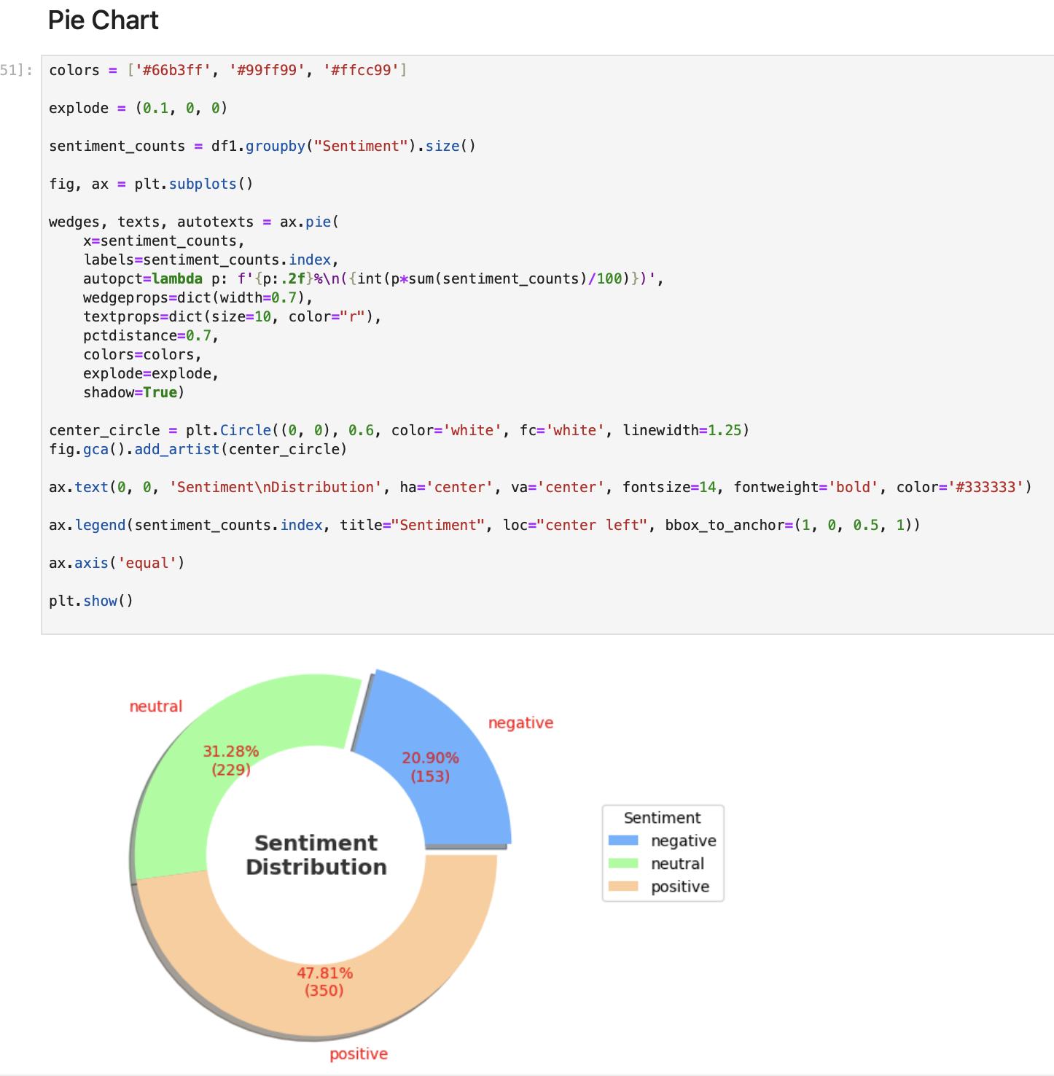
“The sentiment distribution shows that 47.81% of the texts were positive, while 31.28% were neutral, and 20.90% were negative. This means that most of the texts tend to be positive, but there is a significant proportion of texts with neutral and negative sentiments, highlighting the diversity of sentiments in the data.”

Slide 20
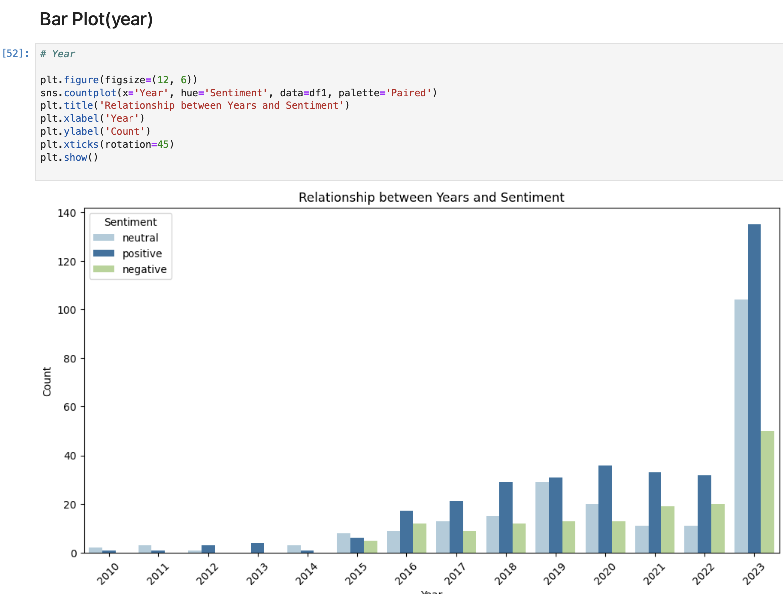
We see a significant increase in data during 2023, with neutral sentiment being the most frequent, followed by positive and then negative. There is also a gradual increase in data since 2020 compared to previous years.”

Slide 21
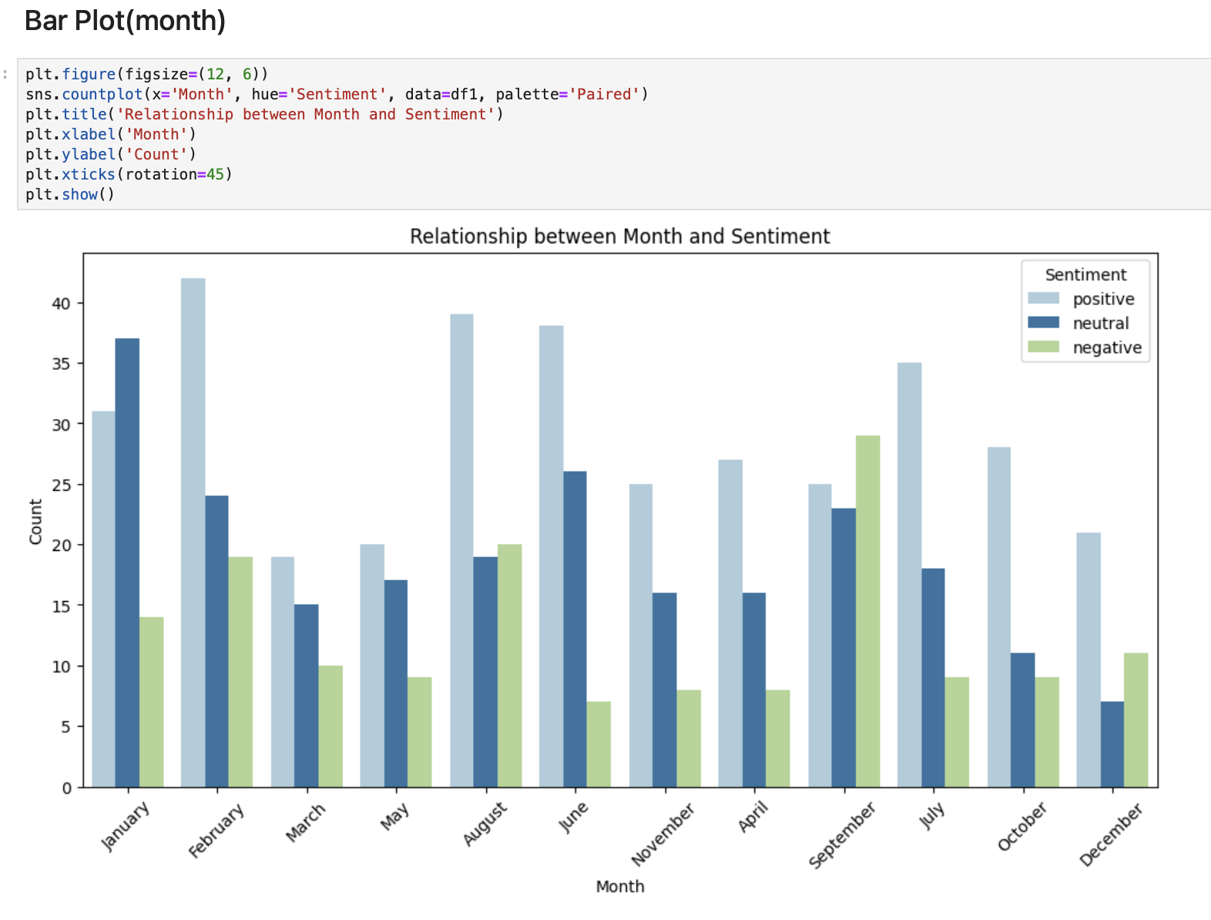
The chart shows the distribution of sentiment over the months. Neutral and positive sentiments are more frequent in January, September and August, while negative sentiments are more prominent in March and September.

Slide 22
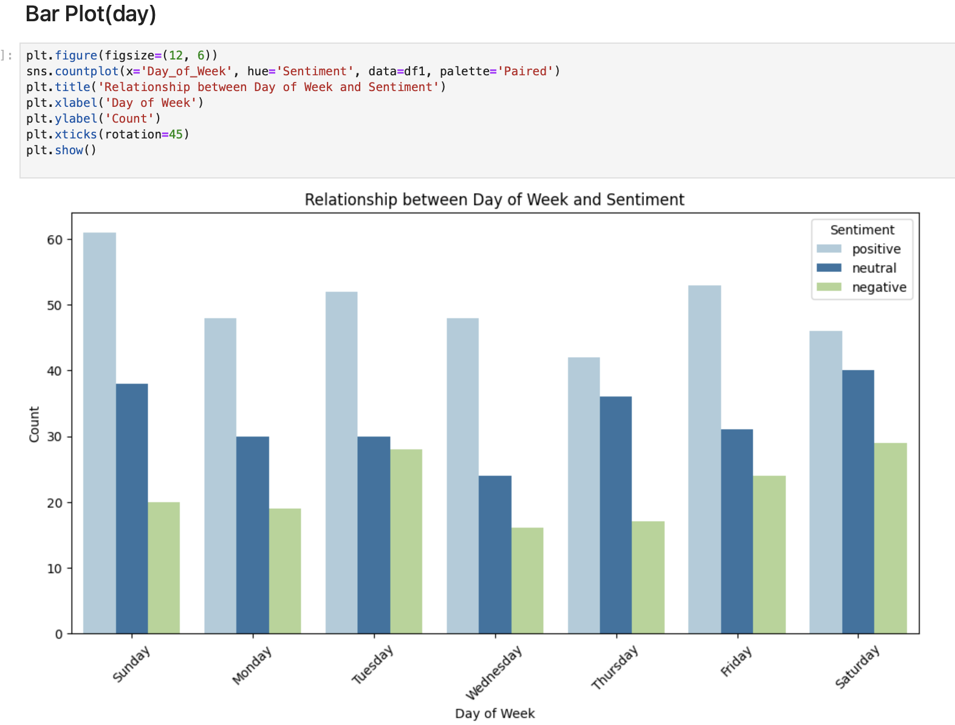
Positive and neutral emotions are more frequent on Sunday and Friday, while negative emotions are less frequent and show a slight increase on Tuesday and Thursday.”

Slide 23
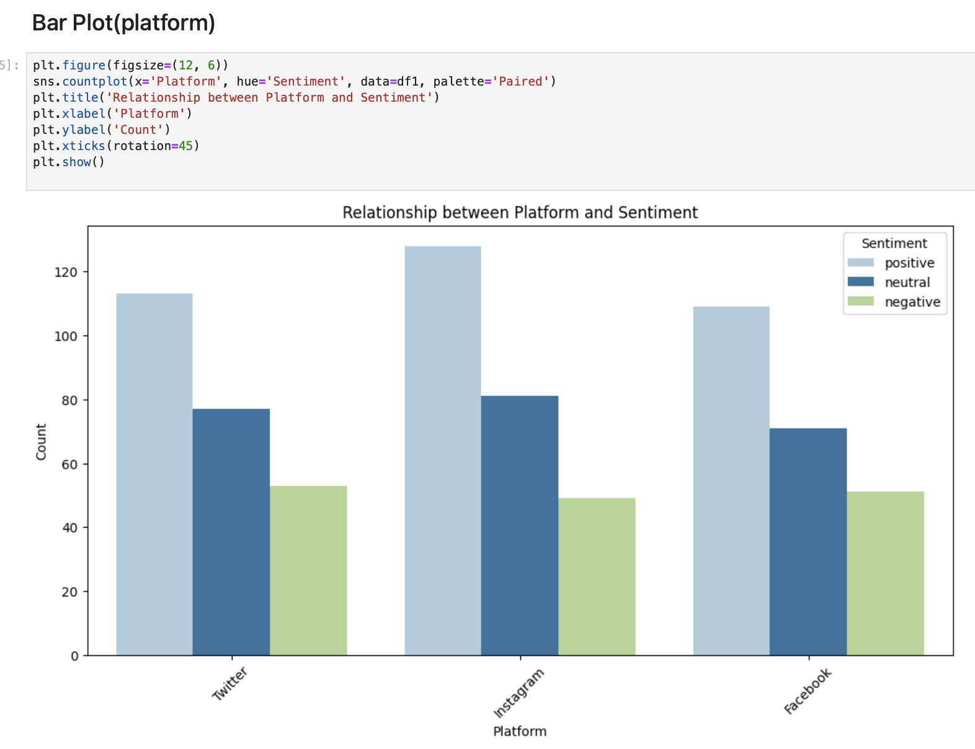
We notice that Instagram has the highest number of positive interactions, while negative sentiments are relatively close across all three platforms.

Slide 24
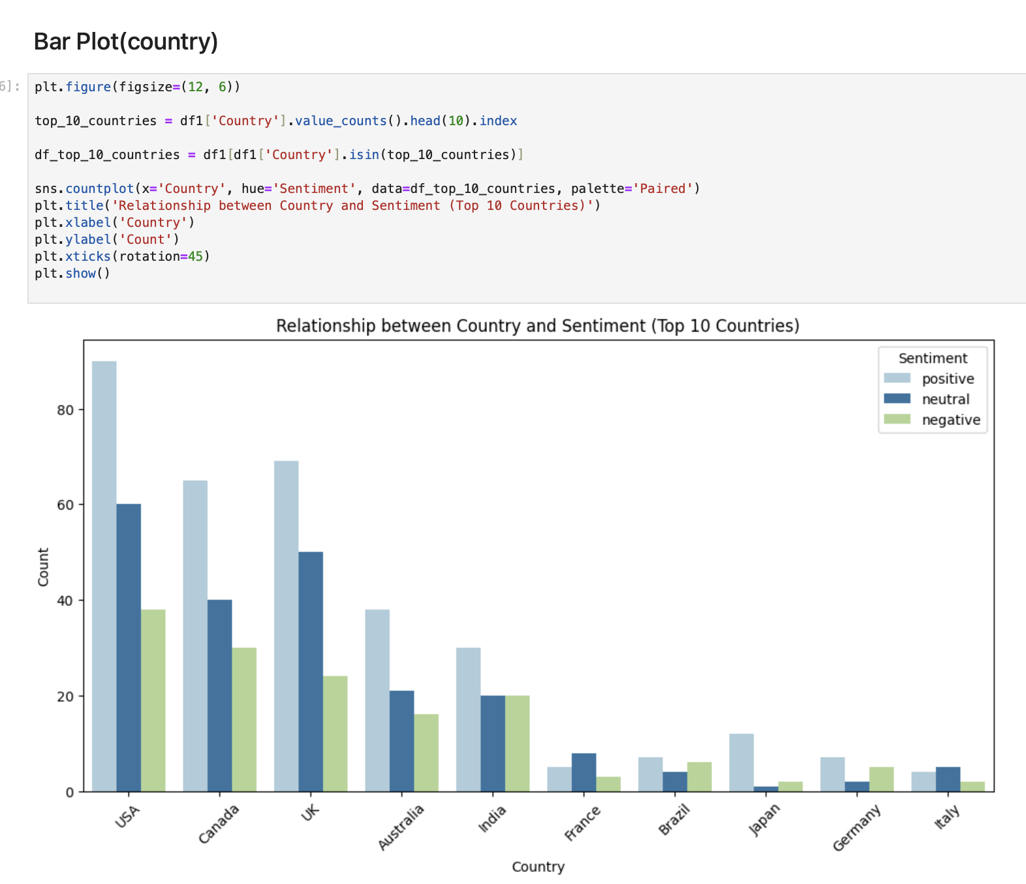
Developed countries stand out with higher rates of neutral and positive interactions compared to other countries."

Slide 25
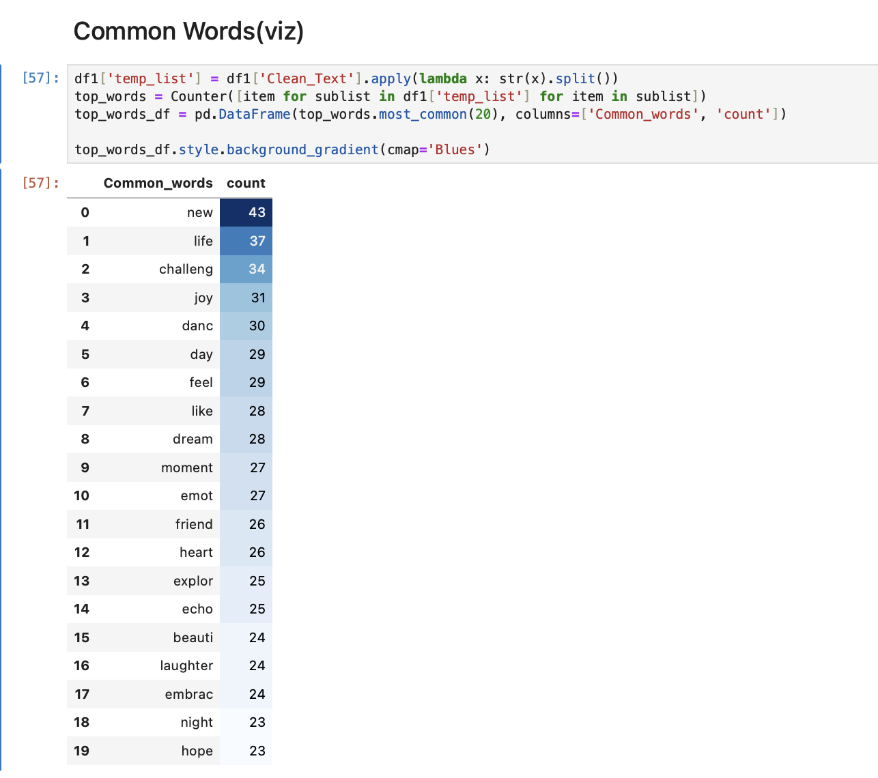
1-Common Words

Slide 26
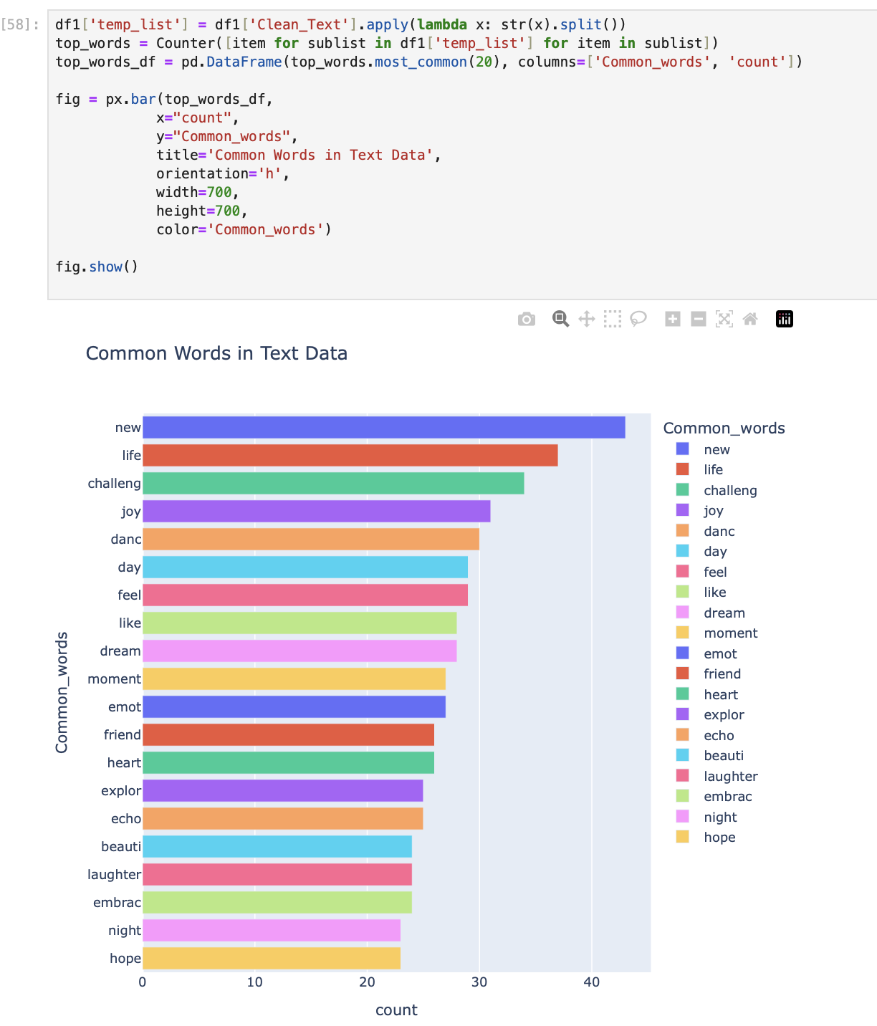
2-Common Words

Slide 27
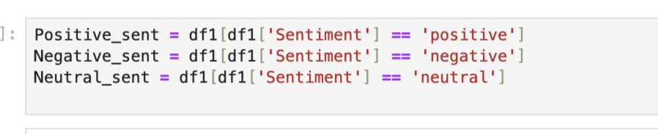
The data is divided into three subsets based on the value of the Sentiment column:
Positive_sent: Contains data with positive sentiment. Negative_sent: Contains data with negative sentiment. Neutral_sent: Contains data with neutral sentiment.

Slide 28
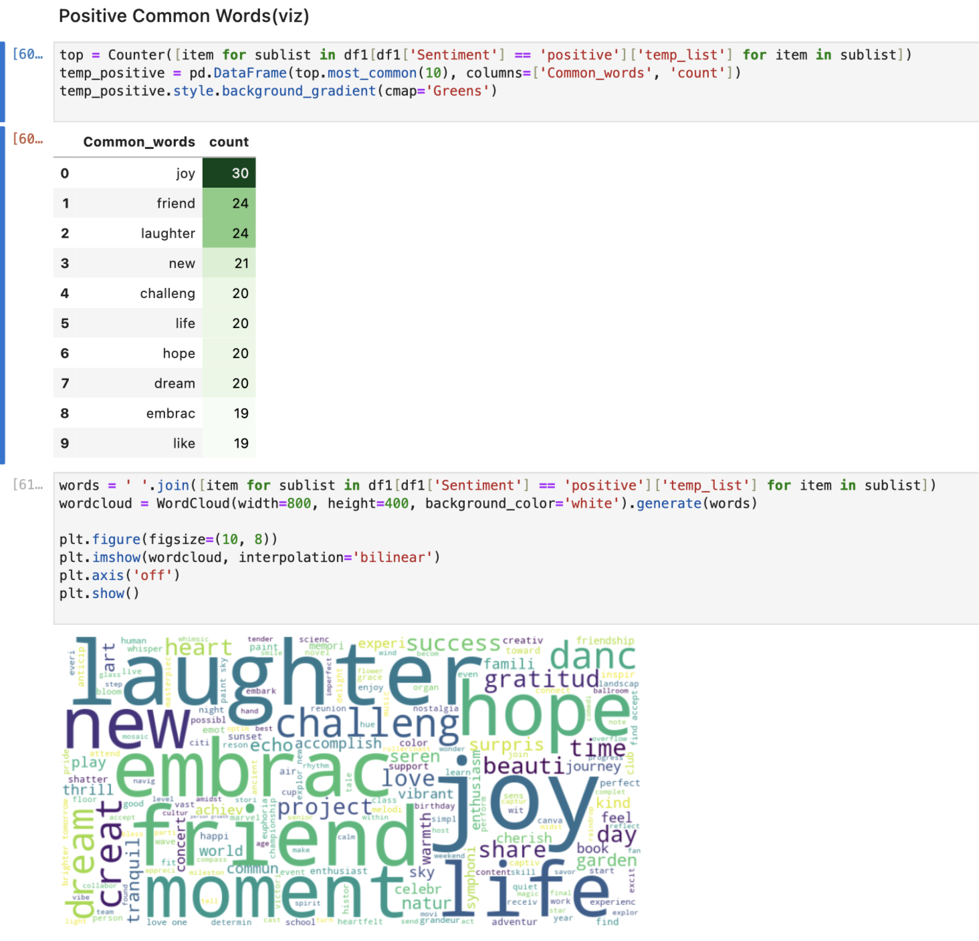
This representation of the data knows how much each word is associated with positive emotions

Slide 29
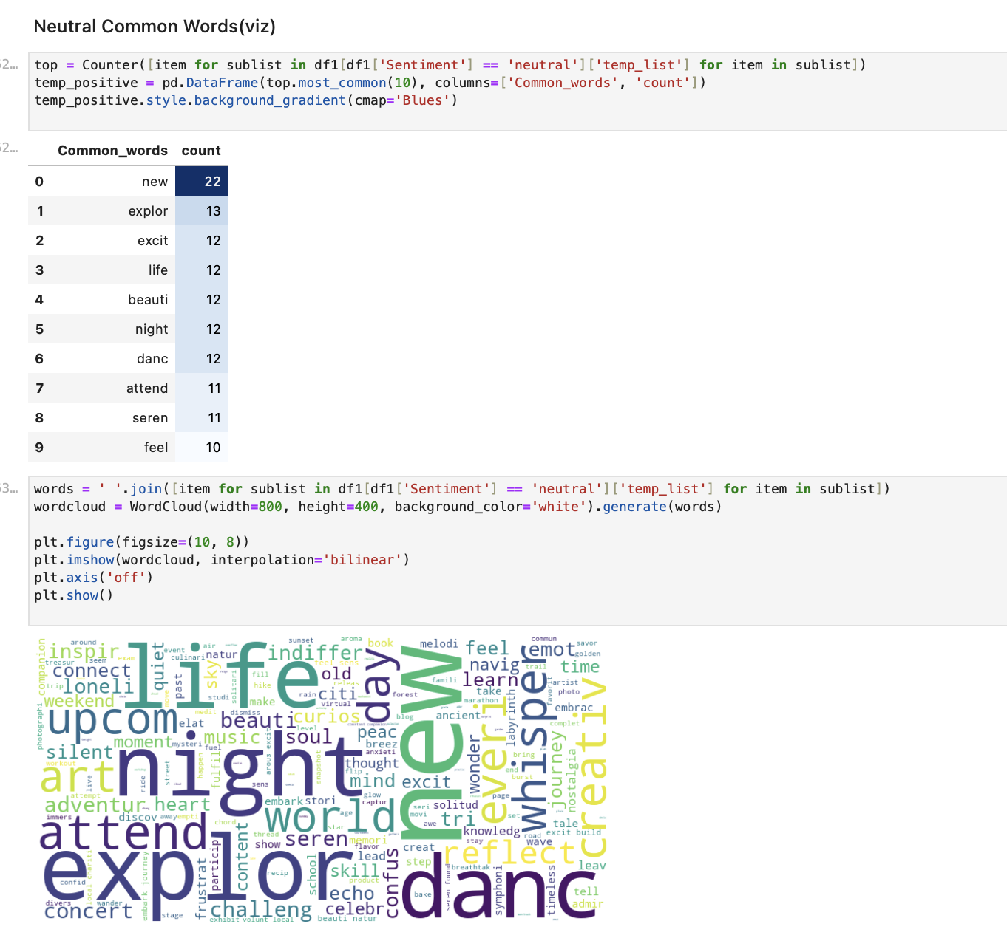
This representation of the data knows how closely each word is associated with neutral emotions

Slide 30
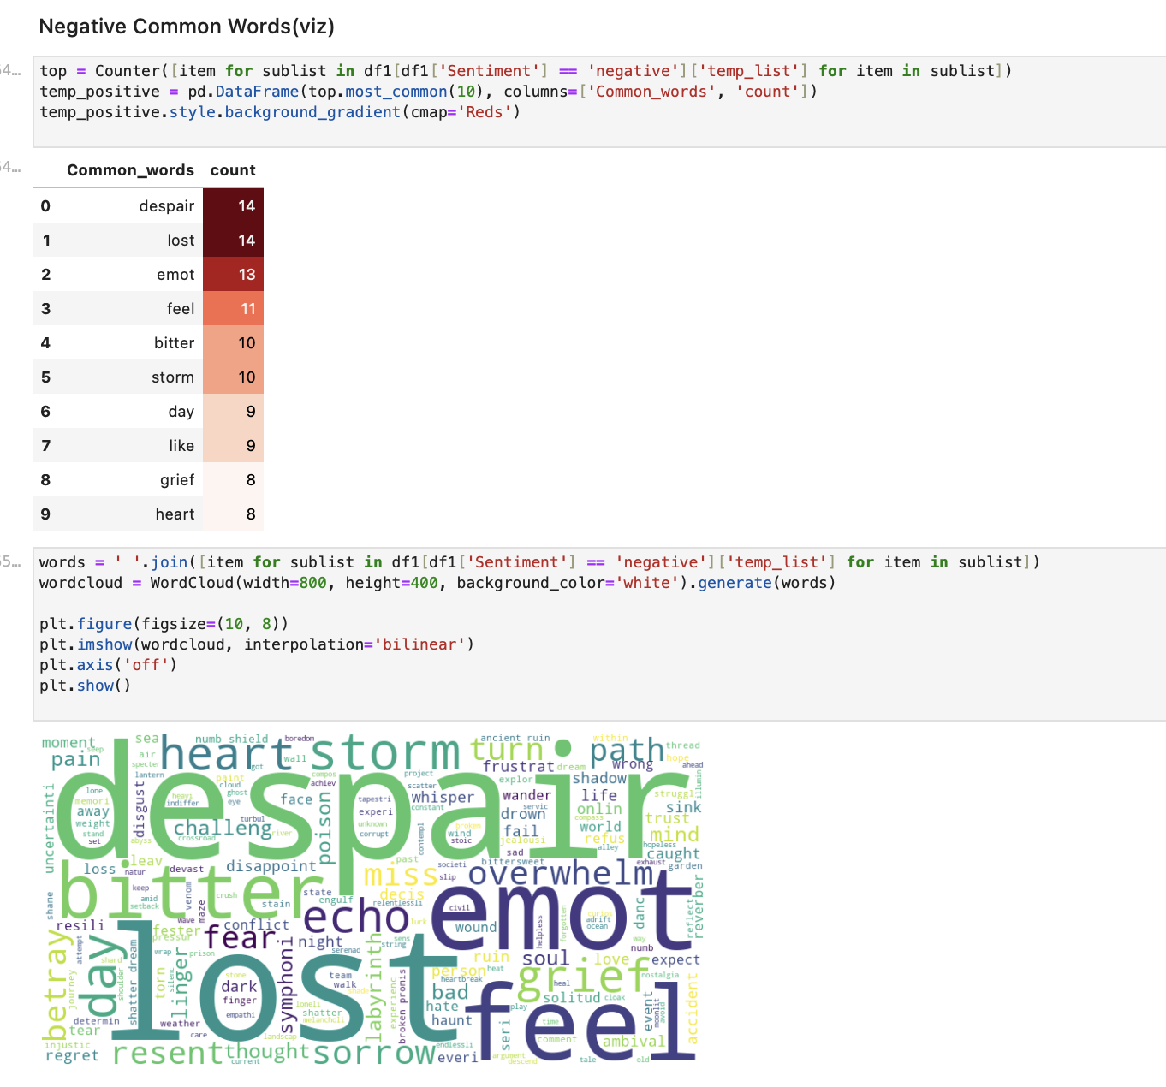
This representation of the data knows how closely each word is associated with Negative emotions

Slide 31
3.4- Model Training:

Slide 32
Data Preparation:
Text Vectorization: Utilized TfidfVectorizer to convert cleaned text into numerical feature vectors with a maximum of 5000 features.
Data Splitting: The dataset was split into training (80%) and testing (20%) sets to evaluate model performance.
Modeling Approaches:
Passive Aggressive Classifier:
Trained and evaluated using the training and test sets.
Achieved accuracy and provided a classification report detailing precision, recall, and F1-score.
Logistic Regression:
Implemented for binary sentiment classification.
Evaluated accuracy and produced a classification report.

Slide 33
Random Forest Classifier:
Trained on the TF-IDF features.
Assessed with accuracy and classification metrics.
Support Vector Machine (SVM):
Another approach for sentiment analysis.
Evaluated with accuracy and provided a classification report.
Evaluation Metrics:
Each model's performance was assessed using accuracy and detailed classification reports, providing insights into their effectiveness in predicting sentiments.

Slide 34
MLFlow Sentiment Analysis Project
Comprehensive Model Training and Evaluation

Slide 35
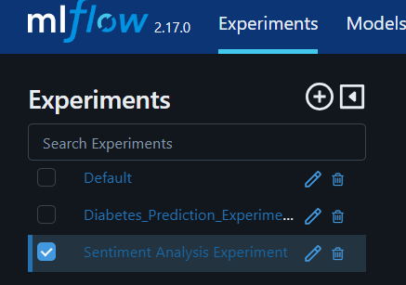
Datasets Used
We utilized well-known datasets for sentiment analysis:

Slide 36
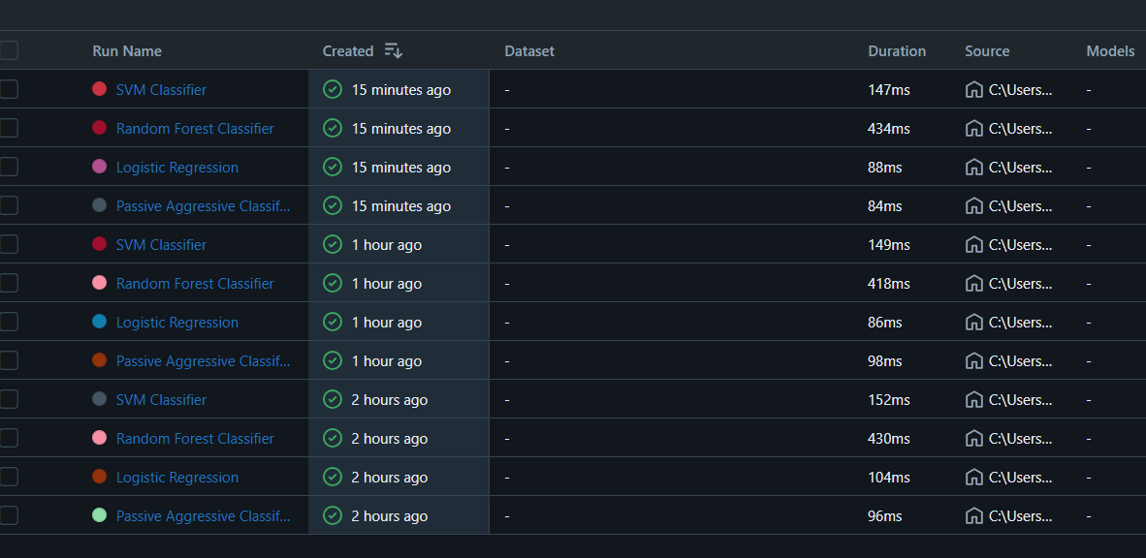
Models Trained
Passive aggressive classifier (PAC)
• Logistic Regression
• Support Vector Machine (SVM)
• Random Forest

Slide 37
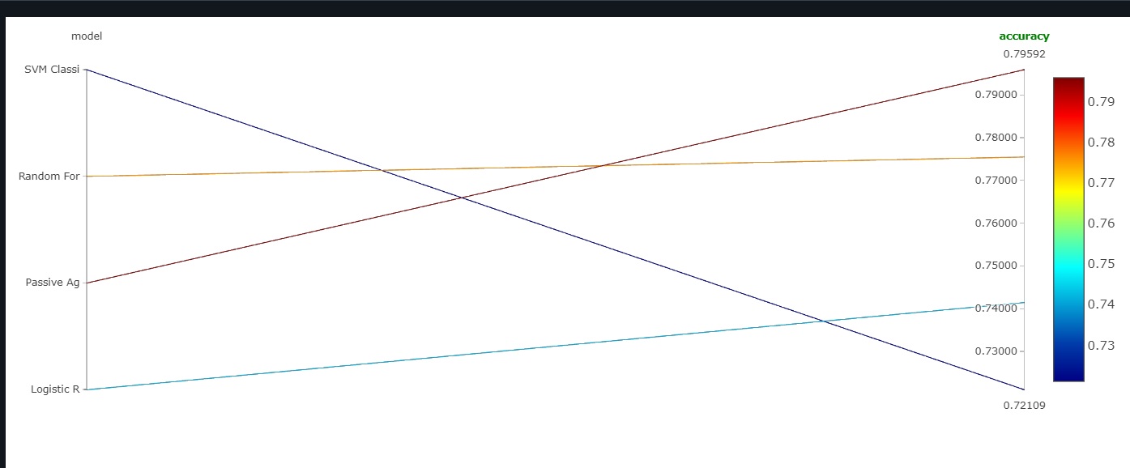
MLFlow for Model Tracking
MLFlow was used for tracking the performance of different models:
• Track metrics such as accuracy, precision, recall, and F1-score.
• Compare model versions and hyperparameter tuning results.

Slide 38
Access the full experiment details here:
MLFlow Link:http://127.0.0.1:5000/#/experiments/619699070373304872?viewStateShareKey=f9cbb98e7827c2a2615434cfc5dbc9f9c23b9a6268feed2a3bef82206d68bb20

Slide 39
MLflow Integration
MLflow for Collaboration: Linking team notebooks and tracking experiments to ensure all models and results are centrally managed.
Experiment Tracking: Tracking model parameters, accuracy, and results for different datasets.

Slide 40

5-Api

Slide 41
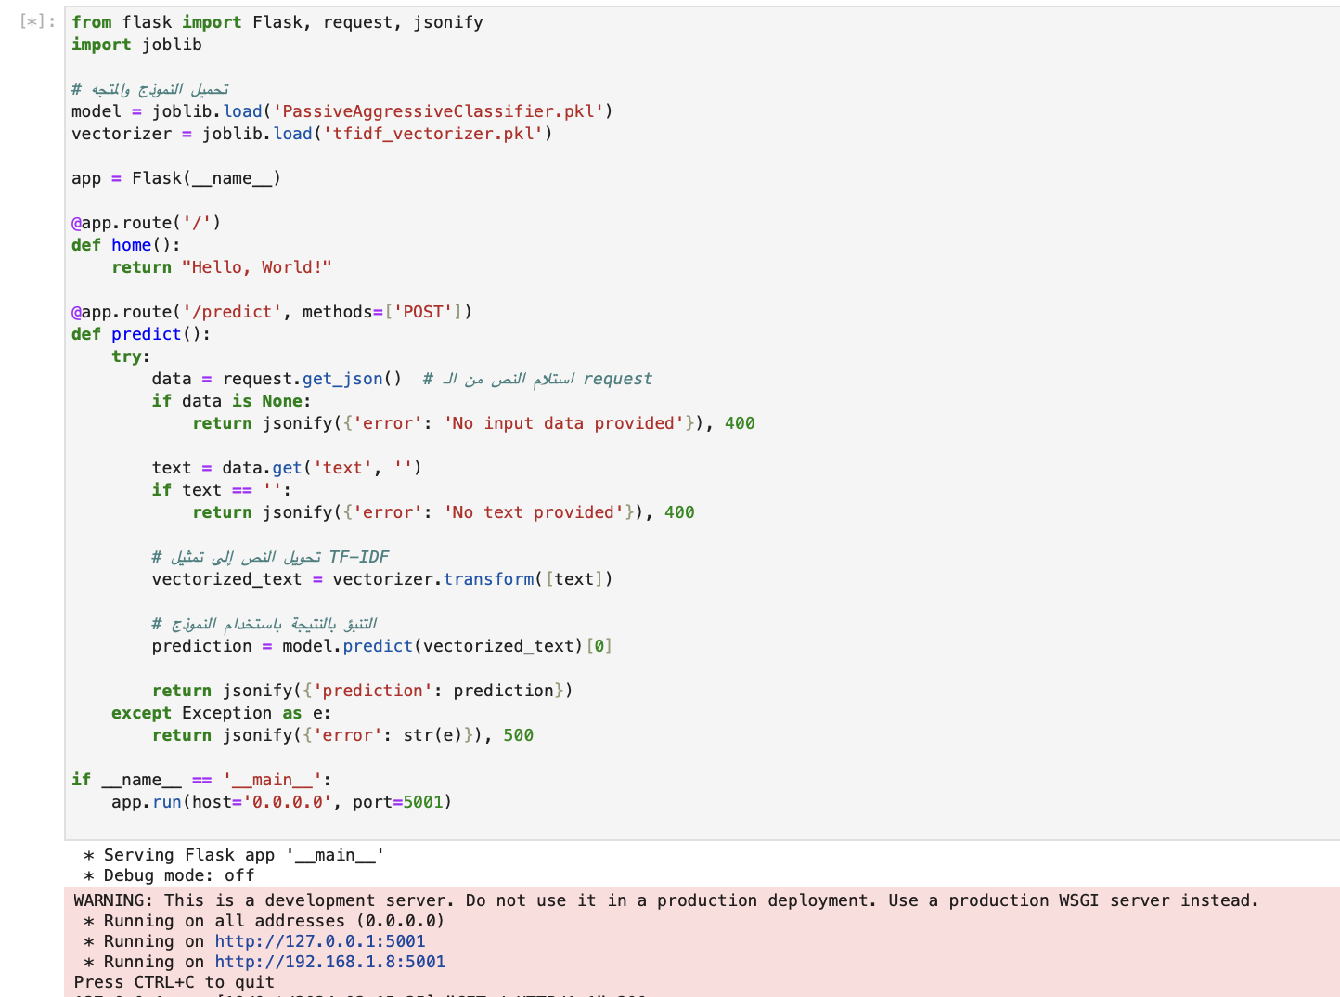
Api flask

Slide 42
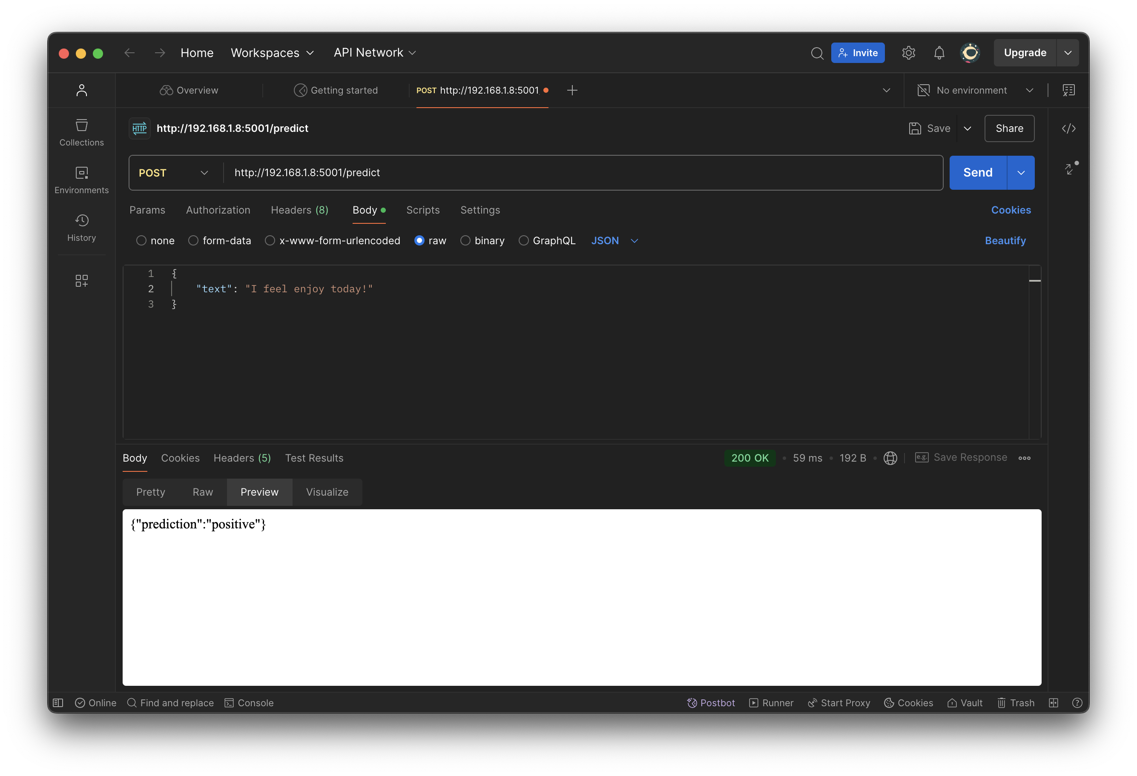
postman

Slide 43

6-Future Work
Utilizing Deep Learning for NLP:
I will leverage Deep Learning techniques, focusing on Natural Language Processing (NLP), to enhance text analysis accuracy and performance.
Developing and Integrating a Web Application:
I will create a web application that integrates the model, allowing users to input text and receive predictions directly within the app.
Organizing Code with Modularization:
I will implement code modularization using tools like Cutter, dividing the project into clean, reusable modules to maintain clarity and scalability.

